Slide 1

Python 201 – A Gentle Introduction to Machine Learning
August, 2020

Slide 2

Agenda
1.
Types of Machine Learning
2.
Machine Learning Pipeline
3.
Machine Learning MATH!
4.
Bias vs Variance
5.
Linear Regression Example
2

Slide 3
Types of Machine Learning
Machine Learning
Supervised
Unsupervised
Reinforcement
Regression
Linear
Polynomial
Clustering
SVD
PCA
K-means
Decision Tree
Continuous
Random forest
Classification
KNN
Trees
Logistic Regression
Naïve-Bayes
SVM
Association analysis
Apriori
FP-Growth
Categorical
Hidden Markov Model

Slide 4
Common Examples
Machine learning exists not only in professional and industry workplaces but also in daily life to assist in everything from medical diagnosis to answering customer questions about products.
01
04
Virtual Personal Assistant
Machine learning is a large part of personal assistants such as Siri, Alexa, and Google Now as they collect and refine information on the basis of previous involvement.
Social Media
The People you may know function uses your profile and its connections to provide suggestions. Similar content uses computer vision to identify and recommend similar things.
02
05
Commuting Predictions
Google Maps, Uber, Lyft, and other apps like these use machine learning to minimize required travel time and avoid traffic congestion.
Spam filtering
Multi Layer Perceptron and C 4.5 Decision Tree Induction are two of the techniques utilizing ML to identify potential spam calls.
03
06
Video Surveillance
Systems that monitor video input and alert users to identified behaviour can save countless hours of human monitoring.
Search Engines
Search results are continuously improved using recommendation engines based on previous behaviour.

Slide 5
Machine Learning Pipeline
A typical machine learning pipeline moves through the eight steps below and frequently moves between steps
Test Set
1
2
3
4
5
6
7
8
1. Problem Definition
2. Data Ingestion
3. Data Preparation
4. Data Segregation
5. Model Training
6. Candidate Model Evaluation
7. Model Development
8. Performance Management
Train Set
Iteration

Slide 6
Machine Learning Math
Machine learning is a field that combines statistics, probability, and computer science to learning iteratively from data. A understanding of the mathematics behind ML concepts is necessary to accurately utilize ML methods.
Why do I need math:
Understand how to select the correct algorithm through considerations on accuracy, training time, model complexity, parameter count, and feature count
Selecting model parameter settings and validation
Evaluate model fit
Estimating confidence intervals and uncertainty
Useful Math Concepts:
Linear Algebra
Principal Component Analysis (PCA), Singular Value Decomposition (SVD), Eigen decomposition of matrices, vector manipulation and spaces
Probability and Statistics
Random variables, standard probability distributions, prior and posterior probability, sampling options
Calculus
Derivatives, integrals, gradients, hessian
Algorithms and optimization
Data structures, gradient/stochastic descents

Slide 7
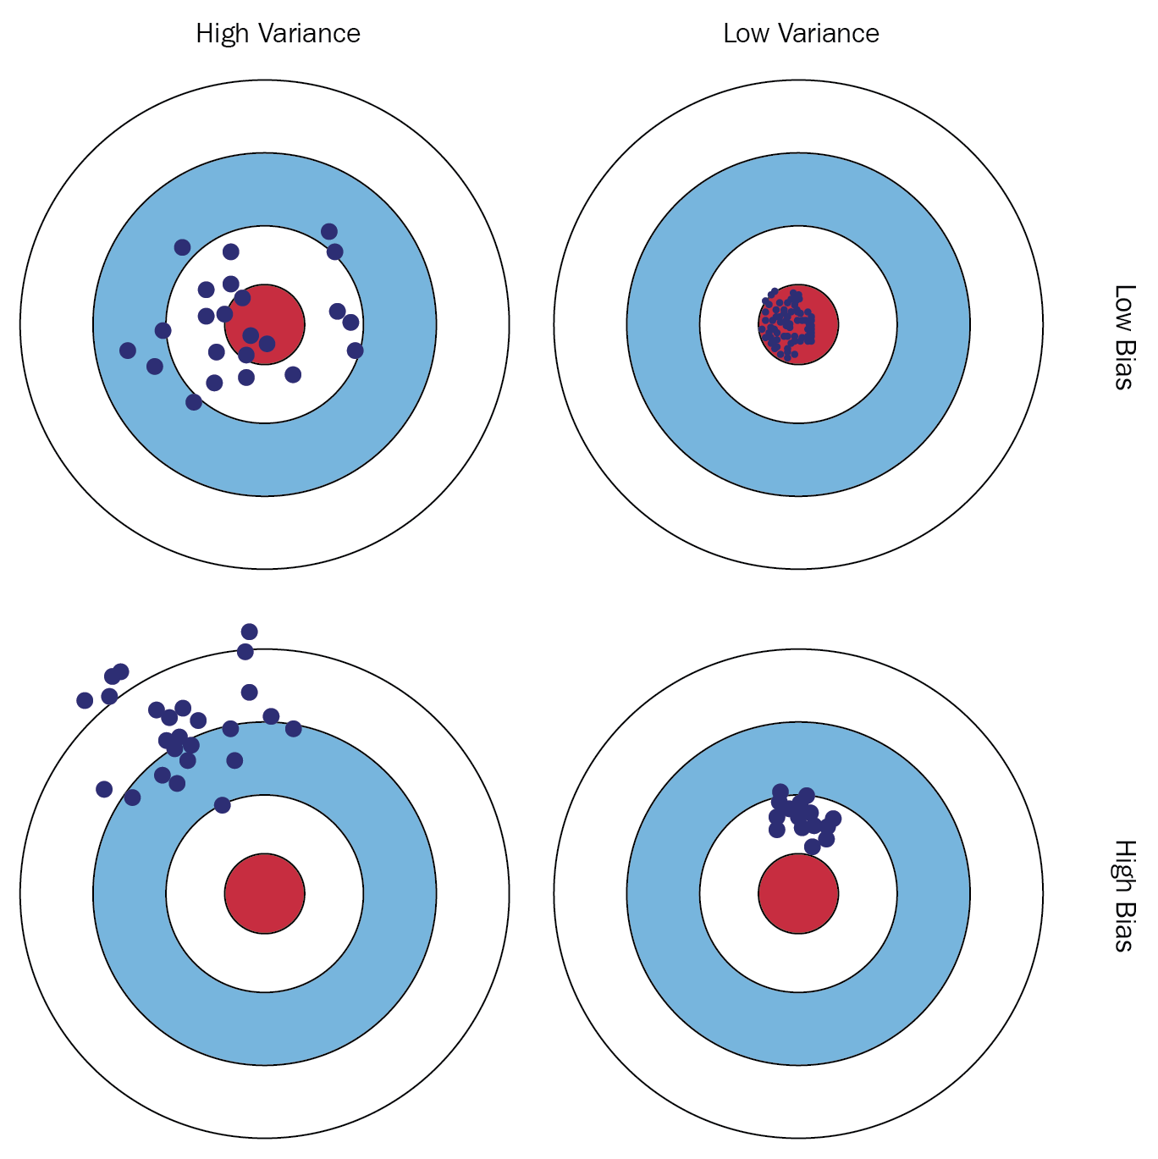
Bias vs Variance Tradeoff
Any machine learning algorithm aims to best estimate the target function of an output variable based on potential input variable. Errors associated with this target function can be categorized in three ways: bias, variance, and irreducible.

Slide 8
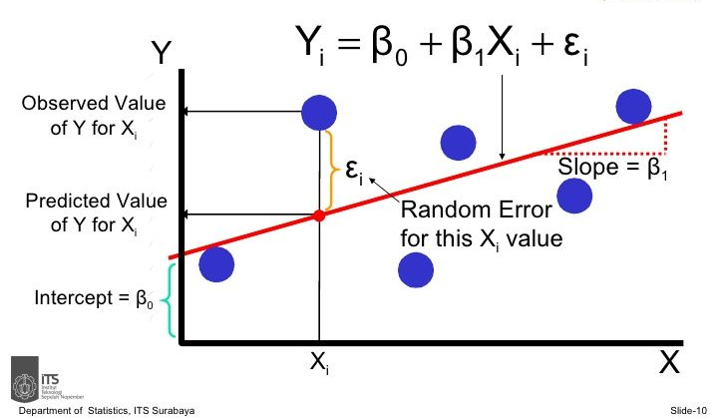
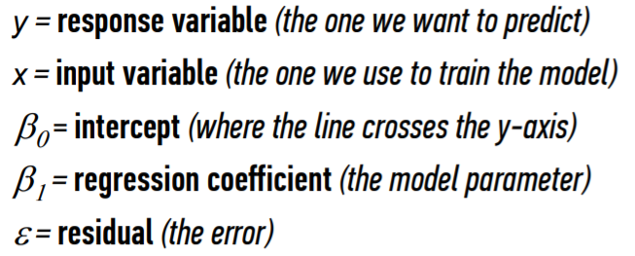
Linear Regression
Overview: Regression analysis is typically used to model the relationship between a single dependent variable Y and one or more predictors.
Why is it used: low operational cost to implement, low tuning cost, easily interpretable output

Slide 9
Linear Regression – interpreting results
It is always necessary to evaluate the model for improvements and there are three main ways to evaluate a linear regression model.
Measurement | Why this measurement | What does it measure?
R-squared | Assess the relative fit of the model | The percent of variance explained by the model
Adjusted R-squared | Assess the relative fit of the model with regards to feature importance | The percent of variance explained by the model with a penalty for including useless features
Root Mean Square Error | Assess the absolute fit (accuracy) of the model | The standard deviation of difference between actual and predicted values

Slide 10
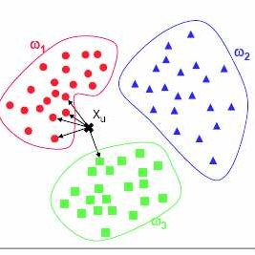
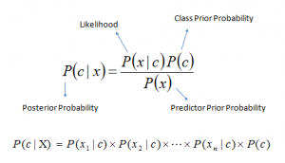
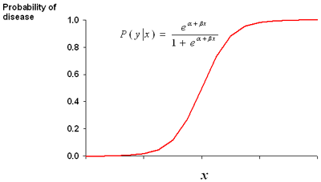
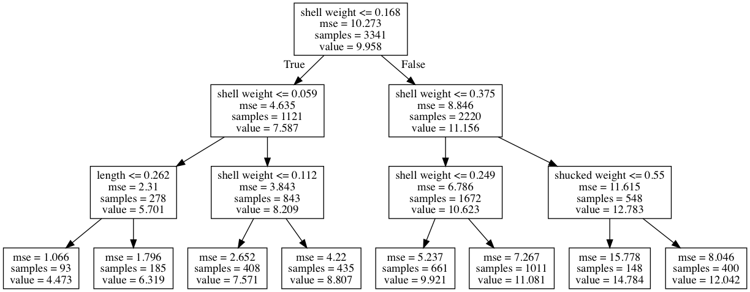
Classification
Overview: Classification is a supervised learning modeling approach that assigns a class label to inputs.
Naïve Bayes:
K Nearest Neighbors:
Logistic Regression:
Decision Trees:
Why is it used: inputs can be put into binary, multi-label, multi-class, and imbalanced classifications

Slide 11
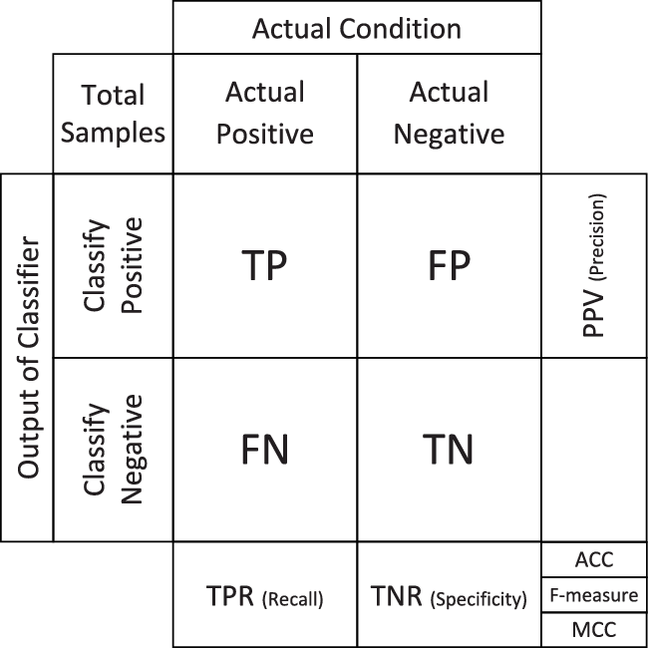
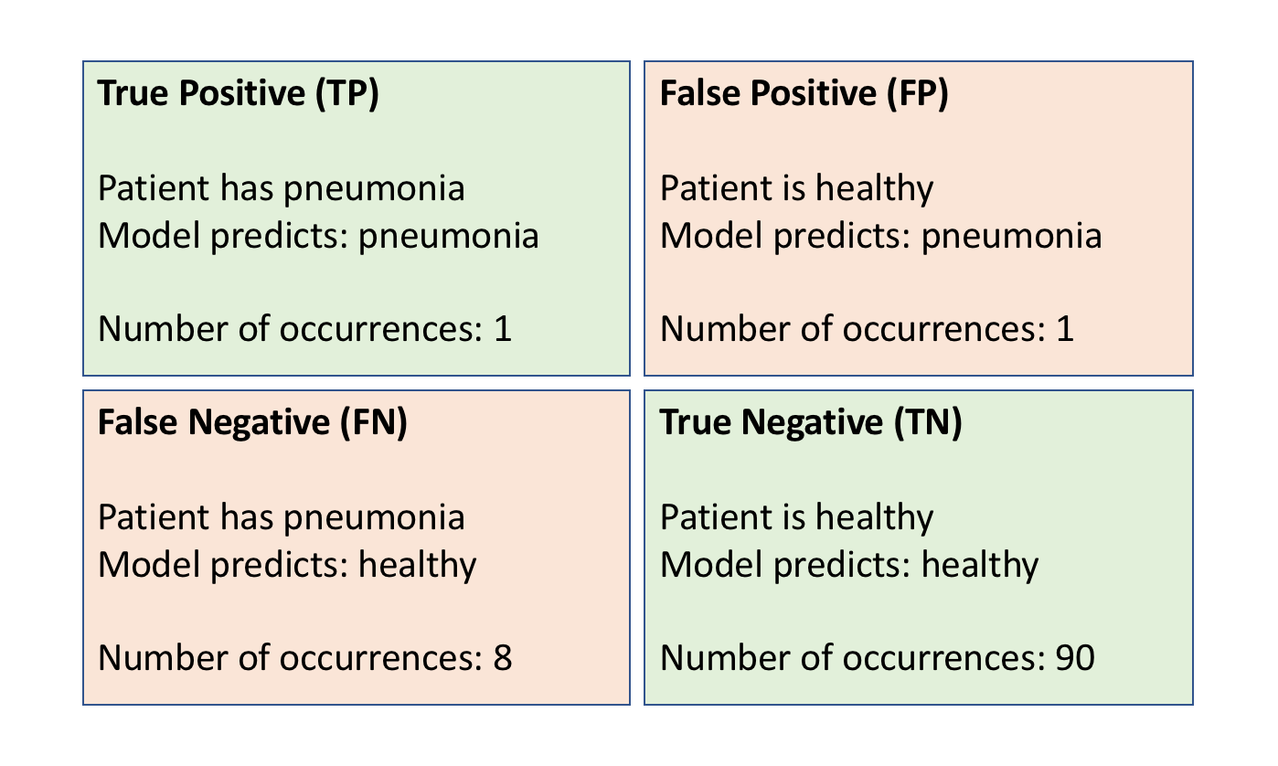
Classification – interpreting results
It is always necessary to evaluate the model for improvements and a confusion matrix is typically used to evaluate classification models.
Example: Confusion matrix for a model predicting if a patient has pneumonia

